Slide 1
Software Design and Analysis CS3004
Engr. Muhammad Umer Haroon

Slide 2
Lecture 7
Domain Modeling

Slide 3
Week 2: Requirements : WHAT to build
Week 3: Use Cases : WHO does WHAT
Week 4: Domain Model : WHAT THINGS exist

Slide 4
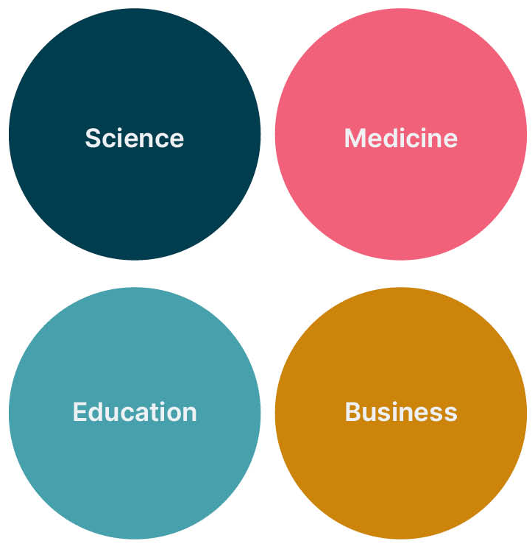
Domain? What is that?
A domain is a collection of related concepts, relationships, and workflows . These are some examples of domains:

Slide 5
Domain Model
A visual representation of conceptual classes (real-world concepts) in the problem domain, showing their attributes and associations.
In UML , the Domain Model is illustrated with a set o f class diagrams without methods.
Also known as Visual Dictionary

Slide 6
confusion
The phrase “domain model” comes from software analysis and design practices, not from the UML specification itself.
UML doesn’t have a separate diagram called “Domain Model.” Instead, analysts use UML class diagrams to visualize the domain model.

Slide 7
Characteristics
Shows WHAT exists, not HOW it's implemented
Uses business vocabulary, not technical terms
Independent of any technology
Focus: understanding the problem, not solving it

Slide 8
The Three Questions Domain Models Answer

Slide 9
1. WHAT concepts/things exist?
Customer, Order, Product, Payment

Slide 10
2. WHAT properties do they have?
Customer has name, address, phone
Order has date, total, status

Slide 11
3. HOW are they related?
Customer places Order
Order contains Products

Slide 12
What Domain Models DON'T Answer
What methods/functions exist?
How data is stored (database design)?
What programming language to use?
User interface design?

Slide 13
Example of a Library System
A library lends books to members. Each book has a title, author, and ISBN. Members have a membership number and contact details. A member can borrow multiple books, but each book can only be borrowed by one member at a time.

Slide 14
Concepts in example
Library
Book
Member
Loan (the act of borrowing)
…………………………..

Slide 15
Attributes (Properties) in example
Book: title, author, ISBN
Member: membershipNumber, name, phone
……………..

Slide 16
Associations (Relationships)
Member borrows Book
Loan connects Member and Book

Slide 17
A domain model is NOT a class diagram with the methods removed. It's a completely different mindset - understanding BEFORE designing.

Slide 18
Identifying Conceptual Classes

Slide 19
Strategy 1: Noun Phrase Analysis
The Technique:
1. Read problem description
2. Underline all nouns and noun phrases
3. Filter out: Attributes (simple properties) Vague terms Redundant terms
4. What remains = candidate conceptual classes

Slide 20
An online store allows customers to browse products and add them to a shopping cart. When ready, the customer proceeds to checkout and enters shipping information. The system calculates the total including taxes and shipping costs. Payment is processed through a credit card. Once confirmed, an order is created and sent to the warehouse for fulfillment

Slide 21
Step 1: Identify Nouns Underlined

Slide 22
An online store allows customers to browse products and add them to a shopping cart. When ready, the customer proceeds to checkout and enters shipping information. The system calculates the total including taxes and shipping costs. Payment is processed through a credit card. Once confirmed, an order is created and sent to the warehouse for fulfillment

Slide 23
Step 2: Filter and Categorize
Noun | Conceptual Class? | Reasoning
Customer | Yes | Primary actor, has identity
Product | Yes | Thing being sold
Shopping Cart | Yes | Contains products, has behavior
Checkout | No | It’s a process/use case, not a thing
Shipping Information | No | Likely attributes of Order
System | No | Too vague; that’s what we’re building
Total | No | Calculated attribute, not a class
Taxes | No | Attribute or calculation
Shipping Costs | No | Attribute
Payment | Yes | Important concept, has details
Credit Card | Maybe | Could be attribute of Payment
Order | Yes | Central concept
Warehouse | Maybe | Depends on scope

Slide 24
Final Conceptual Classes
Customer
Product
ShoppingCart
Order
Payment

Slide 25
Strategy 2: Use Category List (Larman's Common Categories)

Slide 26
Category | Examples
Physical/Tangible Objects | Book, Car, Product, ATM Machine
Transactions | Sale, Payment, Reservation, Registration
Lines of Transactions | SaleLineItem (item in a sale), OrderLine
Roles of People | Customer, Employee, Student, Patient
Places | Store, Warehouse, Airport, Room
Containers | Bin, ShoppingCart, Box

Slide 27
Category | Examples
Things in Containers | Item, Product, Passenger
Organizations | Company, Department, Team
Events | Flight, Concert, Meeting, Appointment
Processes | (Usually NOT classes)
Rules/Policies | RefundPolicy, CancellationRule
Catalogs/Descriptions | ProductSpecification, FlightDescription
Records | Receipt, Log, Ticket

Slide 28
How to Use
When analyzing a problem, mentally go through these categories: Are there any physical objects? Any transactions? Any roles? etc.

Slide 29
Activity
Identify all nouns
Apply filtering
Categorize using Larman's list
Propose final list of conceptual classes

Slide 30
Scenario
A hospital manages patient appointments with doctors. Each doctor specializes in a medical field (cardiology, neurology, etc.). Patients can book appointments through the reception desk or online. The hospital maintains medical records for each patient, including diagnosis history and prescriptions. Doctors can prescribe medications, which are dispensed by the pharmacy. The hospital also manages different departments like Emergency, Pediatrics, and Surgery.

Slide 31
Conceptual Classes: Patient (Role) Doctor (Role) Appointment (Transaction) MedicalRecord (Record) Prescription (Transaction) Medication (Physical/Catalog) Department (Organization) Pharmacy (Place/Organization) Specialty (Catalog/Description)
Classes to Exclude: Reception desk (just a place to book, not a concept)
Diagnosis history (part of MedicalRecord)
Online (delivery mechanism, not a concept)
Point to Ponder :
Why is "Appointment" a class but "booking" isn't? …… Appointment is the THING created, booking is the ACTION
Is "Emergency" a class? ……No, it's a value/type of Department

Slide 32
Attributes of Conceptual Classes

Slide 33
Attribute
An attribute is a logical data value of a conceptual class.
Simple, primitive values (not complex objects)
Examples: name, date, amount, status
In UML: written as attributeName: Type (type optional in domain models)

Slide 34
The Critical Question: "Should X be an attribute or a separate conceptual class?

Slide 35
Rule of Thumb
If X has only simple data → Attribute
If X has its own identity or behavior → Conceptual Class
If X has multiple attributes of its own → Conceptual Class
If you need to track history/changes → Conceptual Class

Slide 36
example
In early domain modeling, when in doubt, prefer attribute. You can always promote it to a class later if needed. Don't over-complicate early.
Customer has name , has address : xyz street lane 4343
Customer has name , has address. Address will have streetno , city, postal code and country
Need to validate by components (postal code format)
Need to calculate shipping based on city/country
Multiple people can share same address
Need to track address history

Slide 37
Attribute Guidelines
Use simple types: String, Integer, Date, Boolean
Use meaningful names: birthDate not bd
Be consistent: if one class uses emailAddress , don't email elsewhere

Slide 38
Avoid a waterfall-mindset big-modeling effort to make a thorough or "correct" domain modelit won't ever be either, and such over-modeling efforts lead to analysis paralysis, with little or no return on the investment.

Slide 39
Lecture 8

Slide 40
Case Study: POS Domain
Sale
Cashier
CashPayment
Customer
SalesLineItem
Store
Item
Register
Ledger
ProductDescription
ProductCatalog
Notes:
Saleslineitem is actually an item in a cart or receipt with its quantity price etc…

Slide 41
There is no such thing as a "correct" list. It is a somewhat arbitrary collection of abstractions and domain vocabulary that the modelers consider noteworthy. Nevertheless, by following the identification strategies, different modelers will produce similar lists.

Slide 42
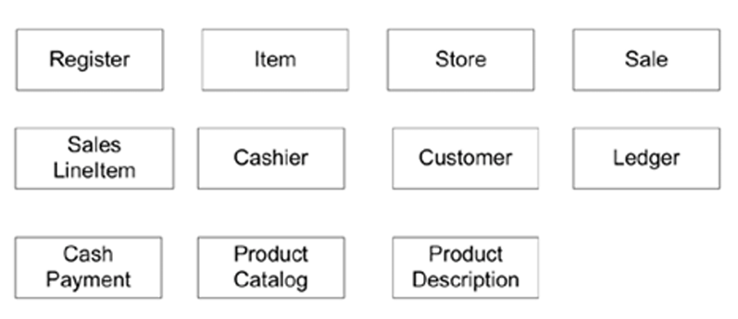
Initial POS domain model

Slide 43
Association
An association is a relationship between conceptual classes that indicates some meaningful connection in the problem domain

Slide 44
Multiplicity on Associations
In a domain model, you do show multiplicity because it expresses domain rules:A Customer can place many Orders → Customer 1..* Order.

Slide 45
Step-by-Step: Creating Your Domain Model
Step 1: List Conceptual Classes
Step 2: Add Attributes
Step 3: Identify Associations
Step 4: Determine Multiplicity

Slide 46
Activity
An airline operates flights between cities. Passengers can book seats on flights. Each flight has a flight number, departure/arrival times, and operates on a specific route. Passengers provide name and contact information. Each booking includes a seat number and booking date.

Slide 47
Validation Technique
Use Case Walk-Through Take a use case and "walk through" the domain model

